Slide 1
Tucker High School STEM Project Scope Overview
Notes:
President Obama has set a priority of increasing the number of students and teachers who are proficient in STEM (science, technology, engineering, and mathematics) fields.
Only 16 percent of American high school seniors are proficient in mathematics and interested in a STEM career.
Among those who do go on to pursue a college major in the STEM fields, only about half choose to work in a related career.
The United States is falling behind internationally, ranking 25th in mathematics and 17th in science among industrialized nations.
In our global economy, this situation is unacceptable. STEM education must be improved if the U.S. is to remain competitive with our international peers.
SOURCE: U.S. Department of Education, Science, Technology, Engineering and Math: Education for Global Leadership, http://www.ed.gov/stem

Slide 2
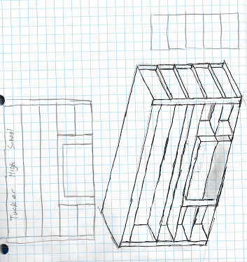
Proposed: Tucker High School Trophy Case and Ecosystem
Project Scope
Location: Lobby
Size 15’x10”x 4 ”
Display Current Awards
Display photos of notable graduates
Aquarium Ecosystem for active learning in oceanography and environmental science
Cost: Estimated $8,000 (THS Foundation and Georgia Case Company)

Slide 3
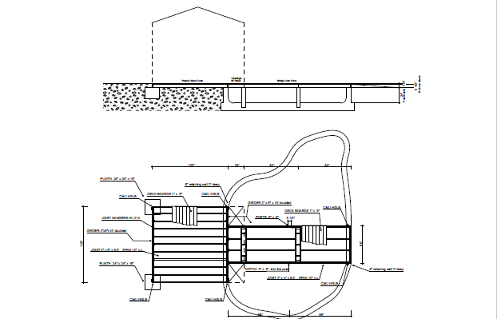
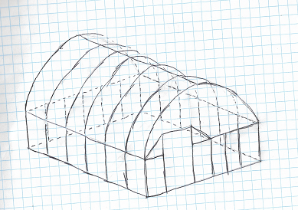
Active: Tucker High School Aquaponics Garden
Project Scope
Location: Garden Area
Pond Size 15’x 8’x 2 ”
Greenhouse Size: 12’ x 12’
Sustainable Practices
Nitrogen Cycles
Eventually Solar Powered
Produce produced for:
Culinary Program
Tucker Farmers Market
Pollinator Garden
International Garden
Cost: Estimated $8,000 (THS Foundation and Georgia Case Company)

Slide 4
Active: Tucker High School Kelley Cofer Lake Study
Project Scope
Location: Kelley Cofer Park
Weekly Data Collection
pH
DO (dissolved Oxygen)
Phosphates
Ammonia
Initial Findings Published
Funding Pending Tucker City Park Proposal
Cost: Estimates Submitted – Pending City Of Tucker Park Proposal

